Slide 1
Amity Institute of Information Technology BCA , Ist Semester Basic Mathematics- Mathematical Logic Dr Sarika Jain

Slide 2
Introduction
Logic is concerned with methods of reasoning. Logical reasoning is the essence of mathematics and is therefore an important starting point for study of discrete mathematics. Logic among other things have provided the theoretical basis for many areas of computer science such as digital logic design, automata theory and computability, and artificial intelligence etc. One component of logic is proposition calculus which deals with statements with value true and false and is concerned with analysis of propositions. The other component is predicate calculus which deals with the predicates which are propositions containing variables.

Slide 3
Propositional Calculus
Propositions
A number of words making a complete grammatical structure having a sense and meaning and also meant an assertion in logic or mathematics is called a sentence. This assertion may be of two types- declarative and non-declarative.
A proposition or statement is a declarative sentence that is either true or false.

Slide 4
Propositions
For example, “Three plus three equals six.” and “Three plus three equals seven.” are both statements. The first because it is true and second because it is false.
Similarly, “x + y >1” is not a statement because for some values of x and y the sentence is true, whereas for others it is false
The truth or falsity of a statement is called its truth value. Since only two possible truth values are admitted, this logic is also sometimes called as two-valued logic.
Questions, exclamations and commands are not propositions.

Slide 5
Examples
The sun rises in the west.
2 + 4 = 6
{5, 6} {7, 6, 5}
The sentences (1), (2) and (3) are statements, the first is false and second and third are true.
Do you speak English?
(is a question, hence not a statement)
5. 4 – x = 8
(is a declarative sentence, but not a statement, since it is true or false, depends on the value of x)
Close the door.
(It is a command, so not a statement)

Slide 6
Examples…..
What a hot day?
(It is exclamation, so not a statement)
8. We shall have chicken for dinner.
(is a statement, since it is either true or false but not both, although one has to wait until dinner to find out if it is true or false)

Slide 7
Examples…..
Simple statements are represented by small letters p, q, r,….. Known as proposition variables.
For example, usually a real variable is represented by the symbol x. This means that x is not a real number but can take a real value.
Similarly, a propositional variable is not a proposition but can be replaced by a proposition.
Propositional variables can only assume two values, true or false.
There are also two propositional constants, T and F, that represent true and false, respectively.
If p denotes the proposition “The sun sets in the west.” , then instead of saying the proposition “The sun sets in the west” is true , one can simply say the value of p is T.

Slide 8
MCQ - 1
Identify which of the following statements are propositions-
France is a country.
2020 will be a leap year.
Sun rises in the west.
: x + 6 = 7
Answer:
Proposition (True)
Proposition (True)
Proposition (False)
Not a proposition (Predicate)

Slide 9
MCQ - 2
Identify which of the following statements are propositions-
This sentence is true.
This sentence is false.
It will rain tomorrow.
Fan is rotating.
Answer:
Proposition (True)
Not a proposition (Inconsistent)
Proposition (Will be confirmed tomorrow whether true or false)
Proposition (True if fan is rotating otherwise false)

Slide 10
Compound Proposition
A proposition consisting of only a single propositional variable or a single propositional constant is called an atomic (primary, primitive) proposition or simply proposition, i.e. they can not be further subdivided.
A proposition obtained from the combinations of two or more propositions by means of logical operators or connectives of two or more propositions or by negating a single proposition is referred to molecular or composite or compound proposition.

Slide 11
Connectives
The word and phrases (or symbols) used to form compound propositions are called connectives.
There are five basic connectives called negation, conjunction, disjunction, implication or conditional and equivalence or biconditional.
The following symbols are used to represent connectives.
Symbol | Connective word | Nature of the statement | Symbolic form
~, ¬ | Not | Negation | ~p
⋀ | And | Conjunction | p ⋀ q
⋁ | Or | Disjunction | p ⋁ q
→, ⟹ | If…..then | Implication or conditional | p ⟹ q
⟺, < -- > | If and only if | Equivalence or biconditional | p ⟺ q

Slide 12
Negation
If p is any proposition, the negation of p, denoted by ~p or ¬p and read as “not p”, is a proposition which is false when p is true and true when p is false.
Consider the statement
p: Paris is in France.
Then the negation of p is the statement
~p: It is not the case that Paris is in France.
Normally it is written as
~p: Paris is not in France.

Slide 13
Negation…..
“not” is a unary operation, since it does not join two statements.
~p is a statement if p is a statement.
The following propositions all have the same meaning:
p: All people are intelligent.
q: Every person is intelligent.
r: Each person is intelligent.
s: Any person is intelligent

Slide 14
Negation…..
The negation of the proposition:
p: All students are intelligent.
~ p: Some students are not intelligent.
~ p: There exists a student who is not intelligent.
~ p: There exist students who are not intelligent.
~ p: At least one student is not intelligent.
Note that “No student is intelligent.” is not the negation of p.

Slide 15
Negation…..
The negation of the proposition:
q: No student is intelligent.
~ q: Some students are intelligent.
Note that “All students are intelligent.” is not the negation of q.

Slide 16
Conjunction and Disjunction
Conjunction and
Disjunction

Slide 17
Conjunction
If p and q are two statements, then conjunction of p and q is the compound statement denoted by p ⋀ q and read as “p and q”. The compound statement p ⋀ q is true when both p and q are true otherwise it is false.

Slide 18
Conjunction…..
Example
p: Ram is healthy.
q: He has blue eyes.
p ⋀ q: Ram is healthy and he has blue eyes.
p: It is cold.
q: It is raining.
p ⋀ q: It is cold and it is raining.
p: 5x + 6 = 26
q: x > 3
p ⋀ q: 5x + 6 = 26 and x > 3.
The connective ‘and ‘ is used in the same sense as the symbol ‘⋀ ‘.

Slide 19
Conjunction…..
p | q | p ⋀ q
T T F F | T F T F | T F F F

Slide 20
Disjunction
If p and q are two statements, the disjunction of p and q is the compound statement denoted by p ⋁ q and is read as “ p or q”. The statement p ⋁ q is true if at least one of p or q is true.
In general, “logical or” is “inclusive or” when either p or q or both are true.

Slide 21
Disjunction…..
Example
p: It is cold.
q: It is raining.
p ⋁ q: It is cold or it is raining.
p: 5x + 6 = 26
q: x > 3
p ⋁ q: 5x + 6 = 26 or x > 3.
The connective ‘or ‘ is used in the same sense as the symbol ‘⋁ ‘.

Slide 22
Disjunction…..
p | q | P ⋁ q
T T F F | T F T F | T T T F

Slide 23
Disjunction…..
Example
Assign a truth value to the following statements:
p: 5 < 5 ⋁ 5 < 6 F ⋁ T = T
5 * 4 = 21 ⋁ 9 + 7 =17 F ⋁ F = F

Slide 24
MCQ - 1
The symbolization for a conjunction is...
p → q
p & q
p ^ q
~ p
Answer: c.

Slide 25
MCQ - 2
In a disjunction, even if one of the statements is false, the whole disjunction is still...
False
Negated
True
True or False
Answer: d

Slide 26
Conditional Proposition
If p and q are propositions, the compound proposition “if p then q” denoted by p →q is called a conditional proposition or implication and the connective is called the conditional connective.
The proposition p is called antecedent or hypothesis and the proposition q is called the consequence or the conclusion.

Slide 27
Example
If tomorrow is Sunday then today is Saturday.
p: Tomorrow is Sunday.
q: Today is Saturday.
If it rains then I will carry an umbrella.
p: It rains.
q: I will carry an umbrella.

Slide 28
Example…..
The connective if p then q can also be read as follows:
p implies q.
p is sufficient for q.
p only if q.
q is necessary for p.
q if p.
q follows from p.
q is consequence of p.

Slide 29
Example…..
The truth table for implication is as follows:
p | q | p → q
T | T | T
T | F | F
F | T | T
F | F | T
The only circumstance under which the implication p → q is false when p is true and q is false.

Slide 30
Example…..
In ordinary language, it is customary to assume some kind of relationship between the hypothesis and the conclusion in using the conditional, but in logic, the hypothesis and the conclusion are not required to refer to the same subject matter.
For example, The statement “If I get the money, then I will buy the computer” sounds reasonable.
On the other hand, a statement such as “ If I get the money then this book is red” does not make sense to us in our convention language.
But according to the definition of conditional, the statement is perfectly acceptable and has a truth value, which depends on the truth values of the statements being connected.
Thus the logic is concerned with the form of propositions to each other and not with the subject matter itself.

Slide 31
Example…..
To understand better, implication can be looked as a conditional promise. If the promise is broken, the implication is false; otherwise it is true. For this reason, the only circumstance under which the implication p → q is false when p is true and q is false.

Slide 32
Example
Which of the following conditional propositions are true?
1. p: The earth is round.
q: The earth travels round the Sun.
Here, p is true and q is true, hence p → q is true.
2. p: Alexander Graham Bell invented telephone.
q: Tigers have wings.
Here, p is true and q is false and hence the p → q is false.

Slide 33
Example…..
Calculate the truth table for p ⋁ ~q → p
p | q | ~q | p ⋁ ~q | p ⋁ ~q → p
T | T | F | T | T
T | F | T | T | T
F | T | F | F | T
F | F | T | T | F

Slide 34
Example…..
Use truth table to show that p → q ≡ ~p ⋁ q
p | q | p → q | ~p | ~p ⋁ q
T | T | T | F | T
T | F | F | F | F
F | T | T | T | T
F | F | T | T | T
The logical equivalence is established by the 3rd and 5th column of the table which are identical.

Slide 35
Biconditional Statement
If p and q are statement, then the compound statement “p if and only if q”, denoted by p ↔ q is called a bicnoditional statement and the connective if and only if the biconditional connective.
The biconditional statement p ↔ q can also be stated as “ p is a necessary and sufficient condition for q” or as “p implies q and q implies p”.

Slide 36
Example
He swims if and only if the water is warm
Sales of house fall if and only if interest rate rises.
The truth table of p↔q is as follows:
p | q | p↔q
T | T | T
T | F | F
F | T | F
F | F | T
It may be noted that p↔q ie true when both p and q are true or false.

Slide 37
Example…..
Show that p↔q ≡ (p ⋁ q) → (p ⋀ q), using
Truth table
Algebra of propositions
By truth table
p | q | p↔q | p ⋁ q | p ⋀ q | (p ⋁ q) → (p ⋀ q)
T | T | T | T | T | T
T | F | F | T | F | F
F | T | F | T | F | F
F | F | T | F | F | T
Truth values in column 3rd and 6th shows the equivalency.

Slide 38
Example…..
By algebra of propositions
p↔q ≡ (p → q) ⋀ ( q → p)
≡ (~p ⋁ q) ⋀ (~q ⋁ p)
≡ [(~p ⋁ q) ⋀~q] ⋁[(~p ⋁ q)⋀ p] Distributive law
≡ [~q ⋀ (~p ⋁ q)] ⋁ [p ⋀(~p ⋁ q)] comm. law
≡ [(~q ⋀ q) ⋁ (~q ⋀ ~p)]⋁[(p ⋀q) ˅ (p ⋀ ~p)] dist.
≡ [F ⋁ (~q ⋀ ~p)] ⋁ [(p ⋀ q) ⋁ F] comp. law
≡ [(~q ⋀ ~p) ⋁ (p ⋀ q)] Identity law
≡ [~(p ⋁ q)] ⋁ (p ⋀ q) DeMorgan’s law
≡ (p ⋁ q) → (p ⋀q)

Slide 39
MCQ - 1
Let p and q be two statements, such that p: Two triangles are congruent and q: two triangles are similar. Then p → q is the statement:
Two similar trianges are congruent.
Two similar trianges are not congruent.
Two congruent trianges are similar.
If two triangles are congruent then they are similar.
Answer: IV.

Slide 40
MCQ - 2
Consider the following statements:
P: Food is good.
Q: Service is good.
R: Restaurant is 5-star.
Write the statements “Service is not good even though the restaurant is 5 star” in symbolic notations.
(Q' Λ R)
(Q' Λ R’)
(Q Λ R)
(P Λ R)
Answer: i).

Slide 41
Converse, Contrapositive and Inverse
There are some related implication that can be formed from p → q.
If p → q is an implication, then the converse of p → q is the implication q → p.
The contrapositive of p → q is the implication ~q → ~p.
The inverse of p → q is the implication ~p → ~q.
The truth table of the four propositions is as follows:
p | q | p → q conditional | q → p converse | ~q → ~p contrapositive | ~p → ~q inverse
T | T | T | T | T | T
T | F | F | T | F | T
F | T | T | F | T | F
F | F | T | T | T | T

Slide 42
Consider the statement
p: It rains.
q: The crops will grow.
The implication p → q states that,
r: If it rains then the crops will grow.
The converse of this implication namely q → p states that,
s: If the crops grow then there has been rain.
The contrapositive of this implication namely ~q → ~p states that,
t: If the crops do not grow then there has been no rain.
The inverse of this implication namely ~p → ~q states that,
u: If it does not rain then the crops will not grow.

Slide 43
Notice that a conditional proposition and its inverse or converse are not logically equivalent.
On the other hand, a conditional proposition and its contrapositive are logically equivalent.
Sometimes, very important theorems can be proved easily when restated in the form ~q → ~p.

Slide 44
Example
Prove that if x² is divisible by 4, then x is even.
Solution
Let p and q be the propositions such that
p: x² is divisible by 4.
q: x is even.
The implication is of the form p → q. The contrapositive is ~q → ~p, which states in words:
If x is odd, then x² is not divisible by 4.
The proof of contrapositive is easy.

Slide 45
Since x is odd, one can write x = 2k +1, for some integer k. hence
x² = (2k + 1)² = 4 k² + 4k + 1 = 4(k² +k +1/4)
Since k² + k is an integer, k² + k + ¼ is not an integer.
Therefore x² is not divisible by 4.

Slide 46
MCQ 1
What will be the Contrapostive of the statement " If it is raining then I get wet".
If I get wet then it is raining.
if it is not raining then will not get wet.
If I will not get wet then it is not raining.
It is not the case that if it is not raining then I get wet.
Answer: iii

Slide 47
MCQ 2
How would you bracket the following formula to correctly interpret it:
p → q ↔ ~ p v q
i) (p → q) ↔ (( ~ p) v q)
ii) (p → q) ↔ ( ~ p v q)
iii) ((p → q ↔ ~ p) v q)
iv) (p → q ↔ ) ~ ( p v q)
Answer: i)

Slide 48
Tautologies and Contradiction
Tautologies
A proposition P is a tautology if it is true under all circumstances. It means it contains the only T in the final column of its truth table.
Example: Prove that the statement (p⟶q) ↔(∼q⟶∼p) is a tautology.
Solution: Make the truth table of the above statement:
p | q | p→q | ~q | ~p | ~q⟶∼p | (p→q)⟷( ~q⟶~p)
T | T | T | F | F | T | T
T | F | F | T | F | F | T
F | T | T | F | T | T | T
F | F | T | T | T | T | T
As the final column contains all T's, so it is a tautology.

Slide 49
Contradiction:
A statement that is always false is known as a contradiction.
Example: Show that the statement p ∧∼p is a contradiction.
Solution:
p | ∼p | p ∧∼p
T | F | F
F | T | F
Since, the last column contains all F's, so it's a contradiction.

Slide 50
Contingency:
A statement that can be either true or false depending on the truth values of its variables is called a contingency.
p | q | p →q | p∧q | (p →q)⟶ (p∧q )
T | T | T | T | T
T | F | F | F | T
F | T | T | F | F
F | F | T | F | F

Slide 51
Logical Equivalence
If two propositions P(p, q, ….) and Q(p, q, …), where p, q,…are propositional variables have the same truth values in every possible case, the propositions are called logically equivalent and denoted by P(p, q, ….) ≡ Q(p, q, …).
It is always permissible and sometimes desirable to replace a given proposition by an equivalent one.

Slide 52
Logical Equivalence…..
To test whether two propositions P and Q are logically equivalent the steps are followed:
Construct the truth table for P.
Construct the truth table for Q using the same propositional variables.
Check each combinations of truth values of the propositional variables to see whether the value of P is the same as the truth value of Q. If in each row the truth value of P is the same as the truth value of Q, then P and Q are logically equivalent.

Slide 53
Algebraic Laws
Algebra of propositions
As in the set theory, propositions also satisfy some laws which are useful to simplify expressions.
1. Idempotent Laws
p ⋁ p ≡ p
p ⋀ p ≡ p
2. Associative Laws
(p ⋁ q) ⋁ r ≡ p ⋁ (q ⋁ r)
(p ⋀ q) ⋀ r ≡ p ⋀ (q ⋀ r)
3. Commutative Laws
p ⋁ q ≡ q ⋁ p
p ⋀ q ≡ q ⋀ p

Slide 54
Algebraic Laws
4. Distributive Laws
p ⋁ (q ⋀ r) ≡ (p ⋁ q) ⋀ (p ⋁ r)
p ⋀ (q ⋁ r) ≡ (p ⋀ q) ⋁ (p ⋀ r)
5. Identity Laws
p ⋁ F ≡ p p ⋀ T ≡ p
p ⋁ T ≡ T p ⋀ F ≡ F
6. Complement Laws
p ⋁ ~p ≡ T p ⋀ ~p ≡ F
~T ≡ F ~F ≡ T
7. Involution Law
~(~p) ≡ p

Slide 55
Algebraic Laws
8. DeMorgan’s Laws
~(p ⋁ q) ≡ ~p ⋀ ~q ~(p ⋀ q) ≡ ~p ⋁ ~q
Using these laws, we can derive absorption law, which is quite important.
Absorption Laws
p ⋁ (p ⋀ q) ≡ p (9a)
p ⋀ (p ⋁ q) ≡ p (9b)
Proof of (9a)
p ⋁ (p ⋀ q) ≡ ( p ⋀ T) ⋁ (p ⋀ q)
≡ p ⋀ (T ⋁ q)
≡ p ⋀ T using identity law
≡ p using identity law

Slide 56
All the laws can be proved using truth table.
Proof of Distributive law: p ⋁ (q ⋀ r) ≡ (p ⋁ q) ⋀ (p ⋁ r)
p | q | r | q ⋀ r | p ⋁ (q ⋀ r) | p⋁ q | p ⋁ r | (p ⋁ q) ⋀ (p ⋁ r)
T | T | T | T | T | T | T | T
T | T | F | F | T | T | T | T
T | F | T | F | T | T | T | T
T | F | F | F | T | T | T | T
F | T | T | T | T | T | T | T
F | T | F | F | F | T | F | F
F | F | T | F | F | F | T | F
F | F | F | F | F | F | F | F
Since the entries in the 5th and the last column are same, so the two propositions are logically equivalent.

Slide 57
Example…..
Show that p↔q ≡ (p ⋁ q) → (p ⋀ q), using
Truth table
Algebra of propositions
By truth table
p | q | p↔q | p ⋁ q | p ⋀ q | (p ⋁ q) → (p ⋀ q)
T | T | T | T | T | T
T | F | F | T | F | F
F | T | F | T | F | F
F | F | T | F | F | T
Truth values in column 3rd and 6th shows the equivalency.

Slide 58
Example
By algebra of propositions
p↔q ≡ (p → q) ⋀ ( q → p)
≡ (~p ⋁ q) ⋀ (~q ⋁ p)
≡ [(~p ⋁ q) ⋀~q] ⋁[(~p ⋁ q)⋀ p] Distributive law
≡ [~q ⋀ (~p ⋁ q)] ⋁ [p ⋀(~p ⋁ q)] comm. Law
≡ [(~q ⋀ q) ⋁ (~q ⋀ ~p)]⋁[(p ⋀q) ˅ (p ⋀ ~p)] dist.
≡ [F ⋁ (~q ⋀ ~p)] ⋁ [(p ⋀ q) ⋁ F] comp. law

Slide 59
Example…..
≡ [(~q ⋀ ~p) ⋁ (p ⋀ q)] Identity law
≡ [~(p ⋁ q)] ⋁ (p ⋀ q) DeMorgan’s law
≡ (p ⋁ q) → (p ⋀q)

Slide 60
MCQ - 1
Which of the following is a tautology?
(a ⋁ b) → (b ⋀ c)
(a ⋀ b) → (b ⋁ c)
(a ⋁ b) → (b → c)
(a → b) → (b → c)
Answer: B.

Slide 61
MCQ - 2
Which of the following statements is correct?
p v q ≡ q v p
~ (p ⋀ q) ≡ ~ p v ~ q
(p v q) ⋁ r ≡ p v (q v r )
All of mentioned
Answer: d).

Slide 62
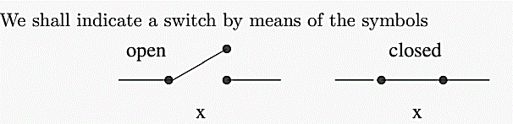

Switching Circuits
A switch is a device which is attached to a point in an electrical circuit.
The switch can be in either of two states, open or closed:
In the open state the switch does not allow current to flow through the point.
In the closed state the switch does allow current to flow through the point.
In principle, ”x“ indicates a sentence such that the associated switch is closed when x is true and it is open when x is false. Another notation is

Slide 63
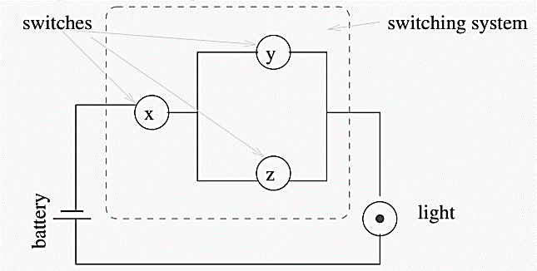
Switching Circuits…..
Two points (available to the outside) are connected by a switching circuit if and only if they are connected by wires on which a finite collection of switches are located. For example, the following
is a switching circuit, making use of an energy source (battery) an output (light) as well as a switching system.

Slide 64
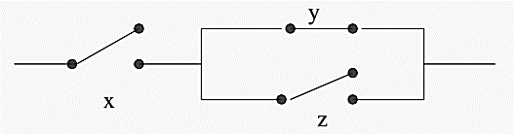
Switching Circuits…..
If switches x and z are open while switch y is closed, then the state of the switching system may be represented by
In order to describe switching systems formally and mathematically, we denote open and closed states by 0 and 1, respectively.
It’s obvious that the state space S for any switch or switching system is composed of two states: 0 (open) and 1 (closed), i.e., S = {0, 1}.

Slide 65
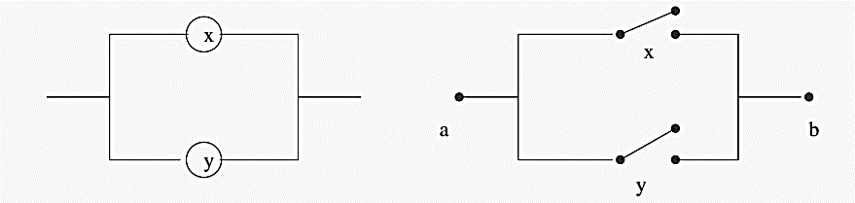

Switching Circuits…..
In a switching system, switches may be connected with one another. In parallel: current flows between points a and b iff x ∨ y is true
In series: current flows between points a and b iff x ∧ y is true

Slide 66
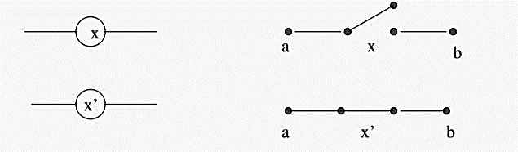
Switching Circuits…..
Through the use of complementary switches: for any given switch x, the corresponding complementary switch, denoted by x’ , is always in the opposite state to that of x.

Slide 67
Switching Circuits…..
Easy generalisation to the case of a finite number of switches x1, x2, . . . , xn:
connected in parallel:
current flows through the circuit iff x1 ∨ x2 ∨ . . . ∨ xn is true.
connected in series:
current flows through the circuit iff x1 ∧ x2 ∧ . . . ∧ xn is true.
For any two switches x and y, we use x + y and x · y to denote their parallel and series connections respectively.
The symbols ”.” and ”+” here shouldn’t be confused with those in the arithmetic, although there exist some similarities.

Slide 68
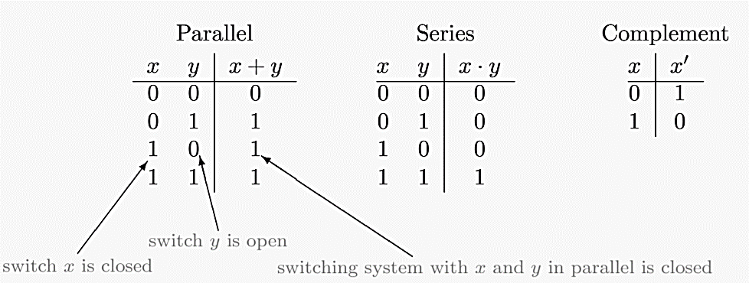
Switching Circuits…..
With the above introduced notations, we can represent the state of, or the effect of switches in parallel, in series and so on by the following tables

Slide 69
Switching Circuits…..
As the special case in the above tables we have in particular 1 + 1 = 1.
Notice a similarity between these tables and truth tables: here 0 can be considered as a F(alse) and 1 as a T(rue).
The first two columns are constructed in a similar way to truth tables (with F’s first instead of T’s) to capture all possible combinations of 0’s and 1’s.

Slide 70
MCQ - 1
If there are ‘M’ switches in series numbered from 1, 2, …, M. For circuit to be complete and bulb to glow which of the following is necessary?
1∧ 2∧ 3 ∧ … ∧M should be on
b) 1∧ 2∧ 3 ∧ … ∧M should be off
c) 1 v 2 v 3 v … v M should be on
d) None of the mentioned
Answer: a).

Slide 71
MCQ - 2
If there are ‘M’ switches in parallel numbered from 1, 2, …, M. For circuit to be complete and bulb to glow which of the following is necessary
1∧ 2∧ 3 ∧ … ∧M should be on
1∧ 2∧ 3 ∧ … ∧M should be off
1 v 2 v 3 v … v M should be on
None of the mentioned
Answer: c).

